Slide 1

Aarhus City Weather Data Analysis
Presented by: Aakash Parwani
Guided by: Professor Sylvain Jaume
Course: DS670 – Capstone Big Data & Business Analytics

Slide 2
Objective
This presentation proposes a review of how atmosphere data examination and representation attempt can help in building framework for sharp urban ranges to stimulate the introduction of splendid city applications for atmosphere envisioning and takes note.
We will understand important parameters that we will use in our analysis.
In this presentation our purpose would be to perform analysis on weather data and dig out important relationships between weather parameters.
And at the end we will figure out key features that really impact weather.

Slide 3
About Data
The city of Aarhus is the second largest city in Denmark situated by the sea in the heart of Jutland. The city has a catchment zone of 1.2 million people inside a one-hour travel go and is especially connected with Copenhagen and Hamburg.
The weather data for the city of Aarhus in Denmark is public for analyses purpose, available at Weather Data . The dataset is a collection of weather observations from the city of Aarhus.
Measurements are recorded from February 2014 – June 2014 and August 2014 – September 2014.
Weather data values are analyzed on the basis of components like - Dew Point, Humidity, Pressure, Temperature, Wind Direction and Wind Speed.
Data provided in online repository is in .Json file format. And in this project we will consider processing of only .Csv file format. So, we will perform transformation of. Json to .Csv file format.
For data analyses and exploration we will use Apache Zeppelin environment more specifically Spark Module.

Slide 4
Weather Parameters
Humidity: - Humidity is the measure of water vapor noticeable all around. Water vapor is the vaporous condition of water and is imperceptible. Humidity shows the probability of precipitation, dew, or haze.
Air Pressure: - Atmospheric pressure, here and there additionally called barometric weight is the weight applied by the heaviness of air in the environment of Earth (or that of another planet).
Temperature: - Temperature is a level of hotness or coldness. It's likewise a measure of how quick the particles and atoms of a substance are moving.
Wind Direction: - Wind direction is represented by the course from which it starts. For example, a northerly wind blows from the north toward the south. The wind bearing will vitally affect the ordinary atmosphere.
Dew Point: - Dew point is the temperature at which airborne water vapor will accumulate to shape liquid dew. A higher dew point suggests there will be more suddenness observable all around. The measurement of dew point is related to humidity.
Wind Speed: - Wind speed, or wind stream speed, is a basic climatic amount. Wind speed is brought on via air moving from high weight to low weight, more often than not because of changes in temperature.

Slide 5
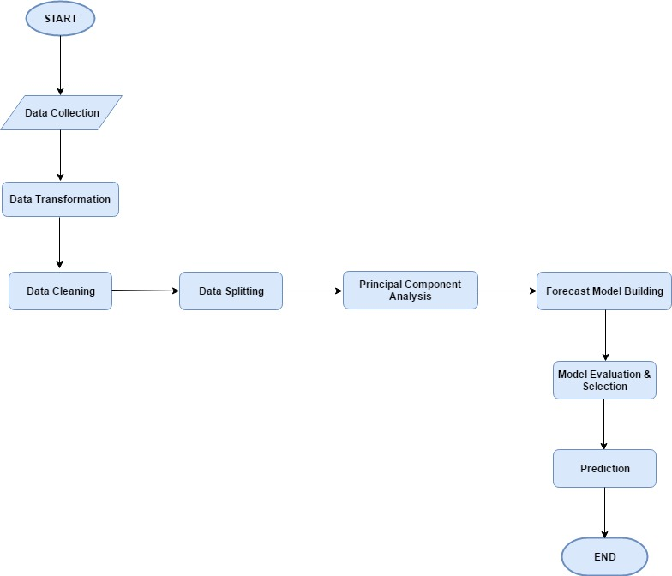
Algorithm Flowchart

Slide 6
Implementation
For implementation of proposed algorithm, we will use Python programming language. Below given are tools and particular libraries .
Tool: - Apache Zeppelin.
Programming Language: - Python.
Data Transformation & Analysis: Pandas, Numpy, Scipy, Matplotlib etc.
Data Cleaning: replace (), drop_duplicates (), cut (), merge (), format () etc.
Data Splitting: partition (), rpartition (), rsplit () etc.
Data Visualization: TABLEAU, PLOTLY, EXCEL.
Principal Component Analysis: Matplotlib, mlabpca ().
Model Building & Evaluation: scipy, Scikit Learn etc.

Slide 7
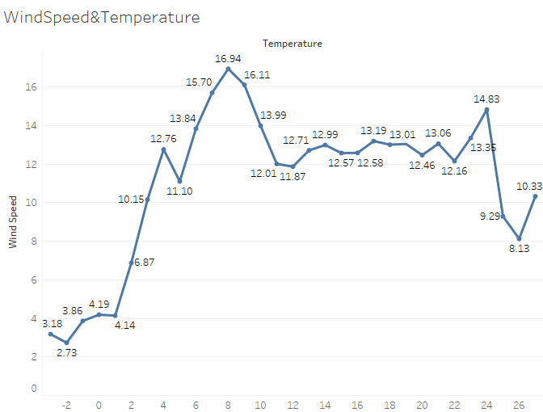
Key Points: -
a. Temperature effects the Wind Speed, wind speed is low when temperature is low.
b. But there is not a directly proportional relationship. Wind Speed is at its peak when temperature is some what around 6 to 10 degree Celsius.

Slide 8
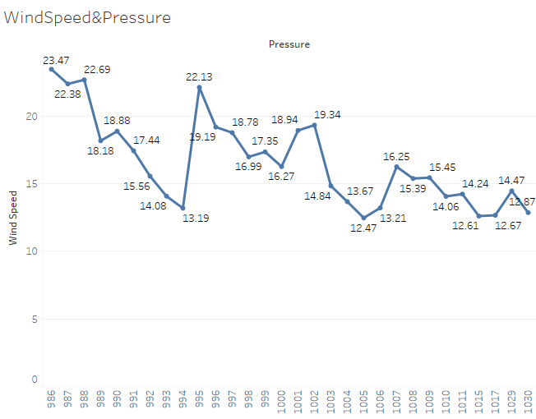
Key Points: -
a. There seems an inversely proportional relationship between Wind Speed & Air Pressure. Wind Speed decreases as air pressure increases.

Slide 9
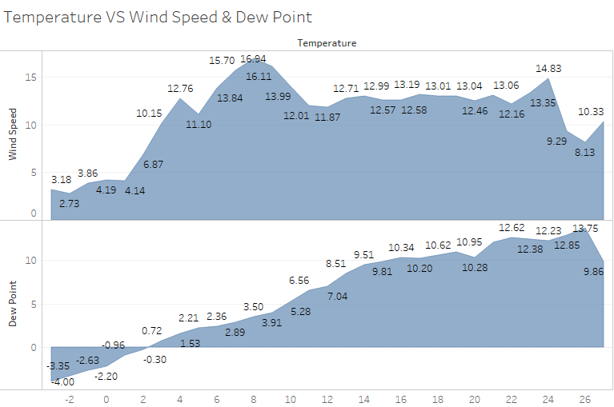
Key Points: -
a. Temperature and Dew Point are directly proportional, as Temperature increases Dew Point will also rise .
b. But Wind Speed start decreasing after certain level of rise in temperature and in our case it is 8 degree Celsius.

Slide 10
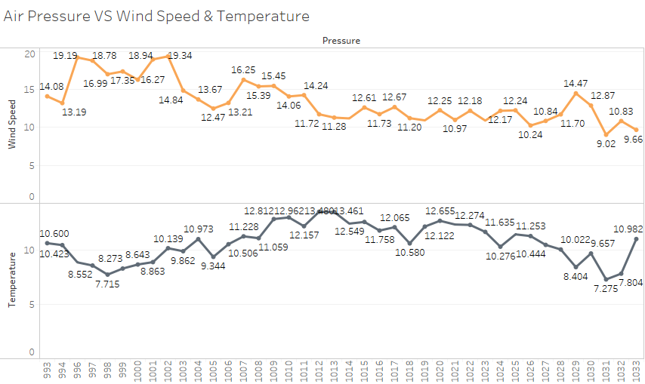
Key Points: -
a. Temperature increases as Air Pressure increases.
b. But as we have already seen in previous slides that Wind Speed decreases with increase in Air Pressure.

Slide 11
Outcomes
From initial analysis of Aarhus city weather data we can draw following conclusions:
During the day the heating land will add energy to the atmosphere, allowing the wind to increase and quite possibly a sea breeze to develop. If we measure wind speed against time we find that on average the maximum wind speed will be at the time of maximum temperature, which is mid-afternoon.
Wind is caused by the movement of air molecules from areas of higher temperature and pressure to areas of lower temperature and pressure. At higher altitudes, or where the average pressure is generally lower, wind will move faster for the same given amount of energy.
Future Enhancements:
Research and Analysis of other important weather parameters like: Altitude etc.
And final outcome of this research would be to predict Wind Speed using the weather parameters we just analysed in this presentation.

Slide 12


